Slide 1
Scipy library
Leo Li

Slide 2
Table of contents
Overview
Functionality
Conclusion

Slide 3
Introduction
Scipy has multiple definitions. As a programming ecosystem, Scipy includes libraries like Numpy, Sympy, Matplotlib, etc. As a library, Scipy provides a range of useful advanced scientific and mathematics algorithms Its primary functions include:
Special functions
Intergration
Optimization
Interpolation
Fourier transforms
Signal Processing
Linear Algebra
…
In this book I will not introduce all the topics, partly due to the limited length of the book, but also partly due to my incapability to understand some of the algorithms
Notes:
Scientific Computing Tools for Python
a collection of numerical algorithms and domain-specific toolboxes, including signal processing, optimization, statistics and much more.
Integration, optimization, interpolation, optimization, etc.

Slide 4
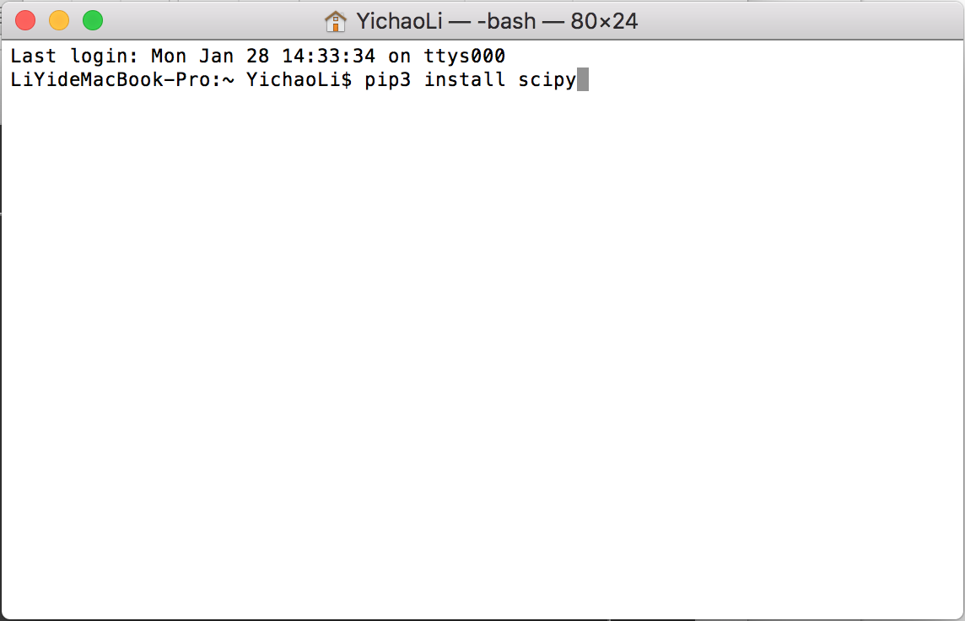
Installation
The installation of the library is rather easy. Just like most other libraries, the scipy library can also be installed via the pip or pip3 install command in the terminal.
Like that easy!

Slide 5
Integration

Slide 6
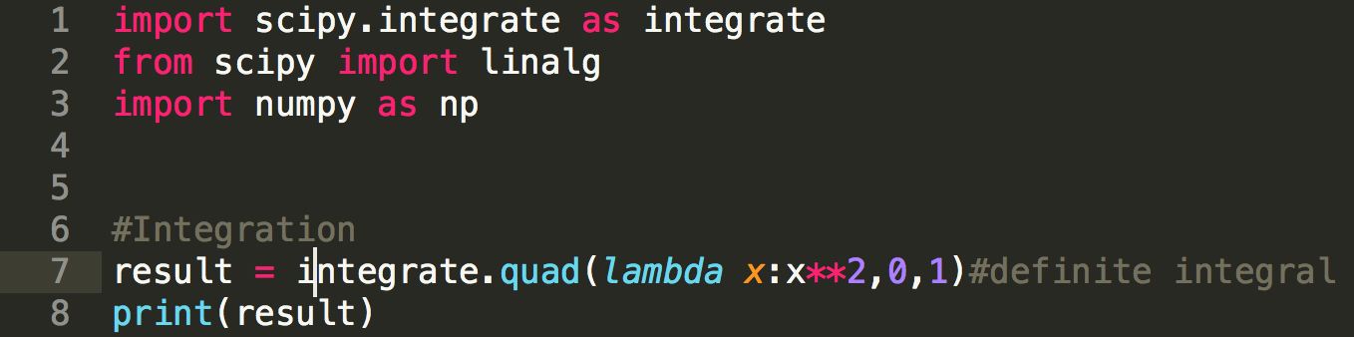
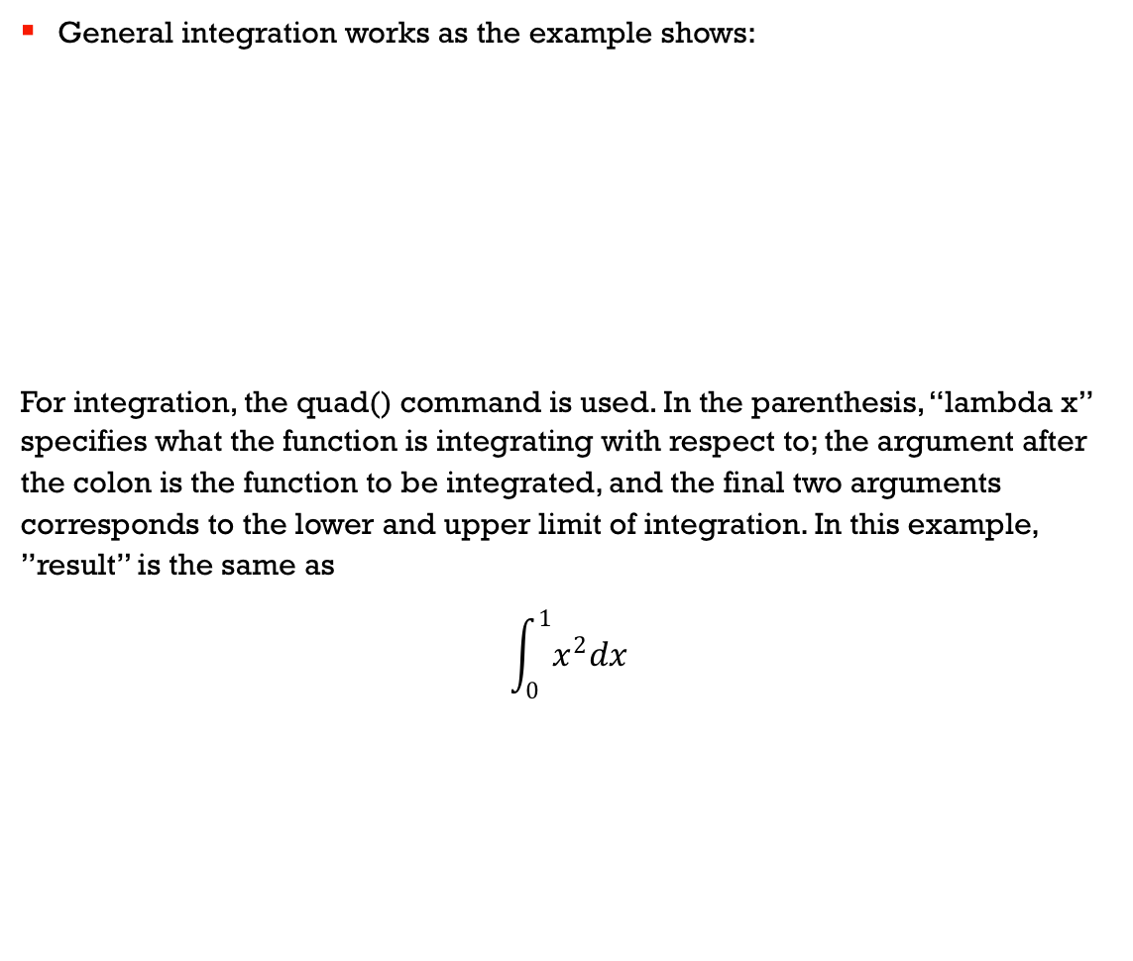
General integration
General integration works as the example shows:
For integration, the quad() command is used. In the parenthesis, “lambda x” specifies what the function is integrating with respect to; the argument after the colon is the function to be integrated, and the final two arguments corresponds to the lower and upper limit of integration. In this example, ”result” is the same as
$$\int_{0}^{1}{x^{2}dx}$$

Slide 7
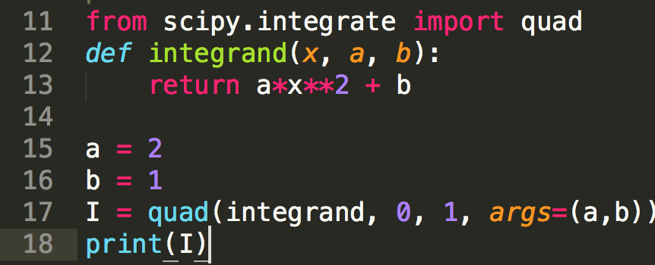
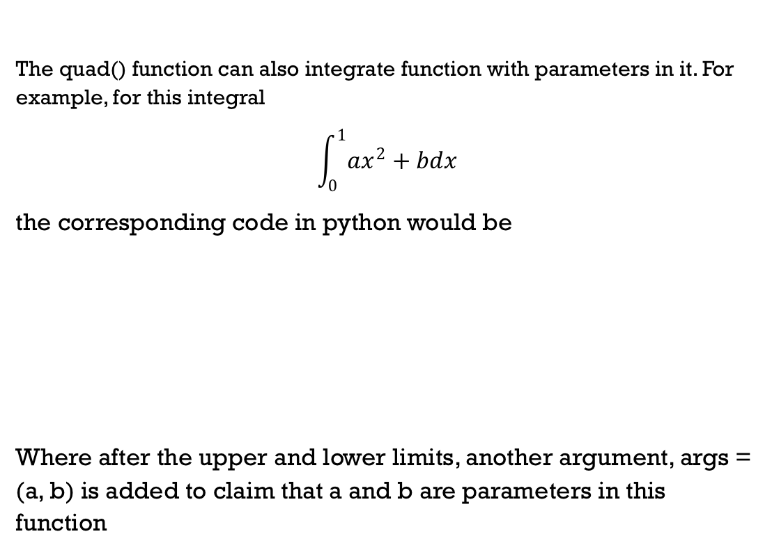
Integrating a function with parameters
The quad() function can also integrate function with parameters in it. For example, for this integral
$$\int_{0}^{1}{ax^{2}+bdx}$$
the corresponding code in python would be
Where after the upper and lower limits, another argument, args = (a, b) is added to claim that a and b are parameters in this function

Slide 8
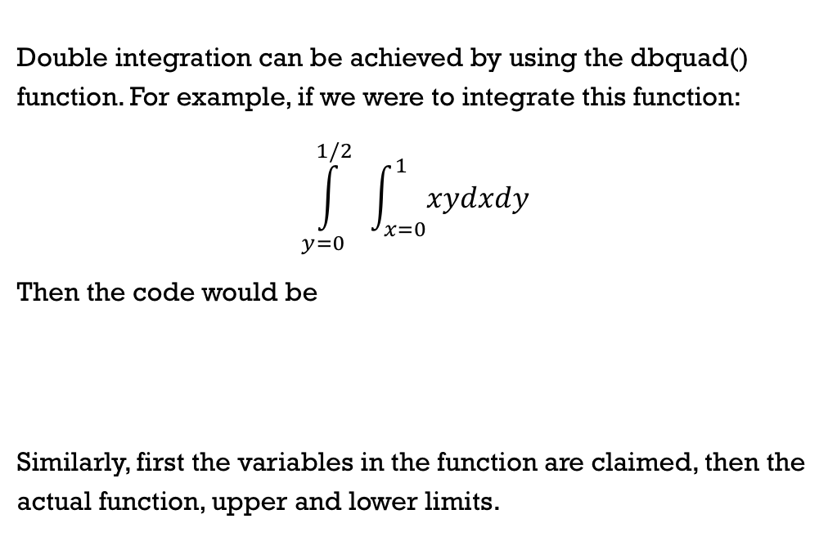
Double integration
Double integration can be achieved by using the dbquad() function. For example, if we were to integrate this function:
$$\int_{y=0}^{1/2}{ }\int_{x=0}^{1}{xydxdy}$$
Then the code would be
Similarly, first the variables in the function are claimed, then the actual function, upper and lower limits.

Slide 9
Matrix operations

Slide 10
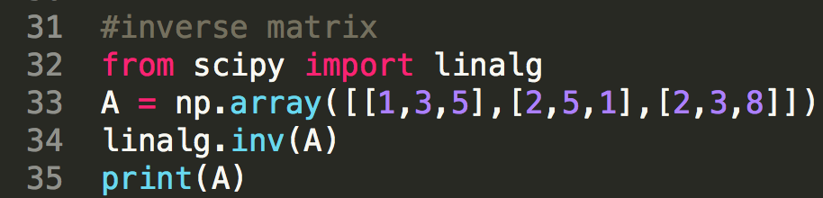

Finding inverse matrix
Vectors and matrices are powerful math tools. Finding inverse of a matrix can also be useful, since it can give one the solution vector of a matrix rather easily. To find a inverse of a matrix, the scipy would use the linalg.inv() function:
This corresponds to calculating the inverse of the matrix
$$\begin{matrix}1 & 3 & 5 \\ 2 & 5 & 1 \\ 2 & 3 & 8\end{matrix}$$

Slide 11
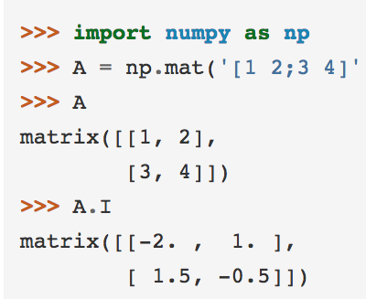
Why not Numpy???
Notice that Numpy seems like a more related library to linear algebra. However, in fact, the scipy library is built on Numpy. In Numpy, if one wants to find a inverse matrix, he would do something like this:
So here the mat() function allows the user to enter a matrix that is stored as data in “matrix” format. This seems convenient and extremely easy to use, but the matrix type data is not as useful as numpy arrays. Arrays are more widely used in all kinds of data processing, while the matrix function serves solely as a matrix.

Slide 12
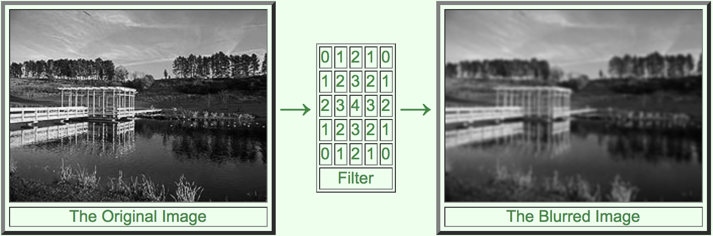
Applications
Matrices can often be related to image processing. An image can be transformed into a matrix, and the image matrix can be operated to manipulate the image. Filter is one of the tools that are used to manipulate images. For example, if we have this blurring filter here:

Slide 13
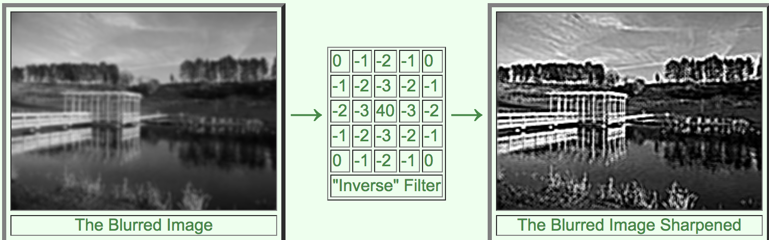
Application
If the user finds the inverse of the blurring filter, and apply it to the blurred image, the user would be able to get a clearer image

Slide 14
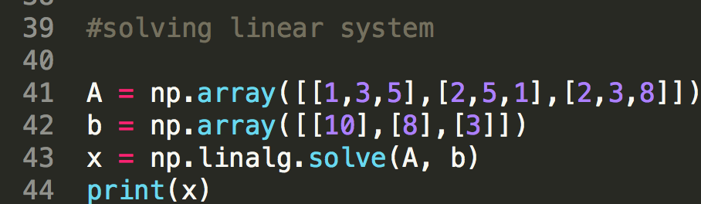
Solving linear system
Solving linear system is the most basic part of linear algebra, the code is rather easy.
For a general linear system, we have Ax=b. In this case, we have A and b as numpy arrays, and use the np.linalg.solve() function to solve the linear system.

Slide 15
Other useful functions
Some other useful functions in the Scipy library are the special functions(Bessel function, Cython bindings for special functions, etc.) and interpolation. The special function part provides a convenient way for mathematicians, scientists, and programmers to access these complicated algorithms. Interpolation can also be very useful. A 2d image can also be seen as a contour map where colors represents the z value at a certain point. By using interpolation, filters can be applied to the image, and a blurred image can be smoothened.

Slide 16
Conclusion
In this book I have only mentioned functions that are the easiest to understand. As I mentioned in the beginning, the Scipy library has a lot of other advanced algorithms that are hard to understand as a high school student. This might not be useful for us now, but maybe it will one day in the future.

Slide 17
Sources
https://docs.scipy.org/doc/scipy/reference/
https://www.cs.cornell.edu/boom/2003sp/ProjectArch/ConjugateGrad/index.htm

